Slide 1
Argument Parser
Group A
Alix Rosarion, Kris Daye, Sari Sabouh, Steven Dudchock, Yi Chen, & Nikki Pruitt

Slide 2
Description
Argument Parser makes it possible for users to parse command line arguments. The product owner predefines the arguments, while the parser determines how exactly to parse the arguments. In order to use the Argument Parser, the product owner must instantiate an instance of the Argument Parser and add the necessary arguments.

Slide 3
Product Backlog
Help text by default
User determined data types
Optional arguments read from any position
Allow for default values for optional arguments
Optional arguments as flags
Allow short names for optional arguments
Allow argument information to be loaded from and written to a XML file
Allow arguments to have a specified number of values
Required optional arguments
Restricted values
Mutually exclusive groups for optional arguments

Slide 4
Arguments
There are two types of arguments: positional and optional.
Positional arguments (or simply arguments), are the arguments expected to be present by the parser.
Optional arguments are arguments that may or may not be present, and can alter the results of the parser.

Slide 5
Argument Features
Arguments have the following attributes:
Title
Data type
Description
Value
Number of values
Arguments are always required if declared
Arguments can have a restricted set of values
Values are assigned based on the order the arguments are created
Argument data type and value data type must match
Arguments can be assigned multiple values

Slide 6

How to Add an Argument

Slide 7
Optional Argument Features
Optional arguments have the following attributes:
Title
Data type
Description
Value
Number of values
Shorthand name
Optional arguments can be:
Set as required
Put into mutually exclusive groups
Assigned a restricted set of values
Placed at any position in the command line
Assigned a default value
Set as a flag

Slide 8
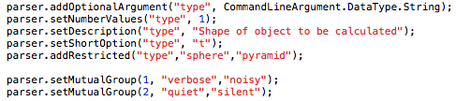
How to Add an Optional Argument

Slide 9
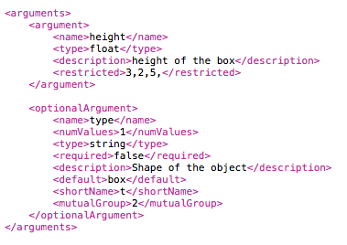
Loading from XML
Arguments and optional arguments can be read into Argument Parser from a previously formatted xml file
XML file specified within the constructor

Slide 10
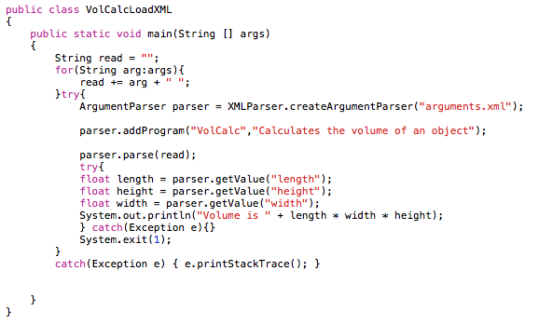
Loading from XML

Slide 11
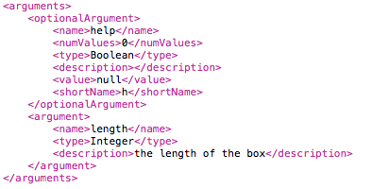
Writing to XML
Arguments and optional arguments can be written to an XML file once defined in the main
The product owner can determine the name of the file to be saved

Slide 12
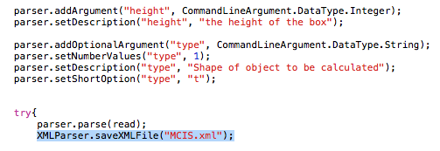
Writing to XML

Slide 13
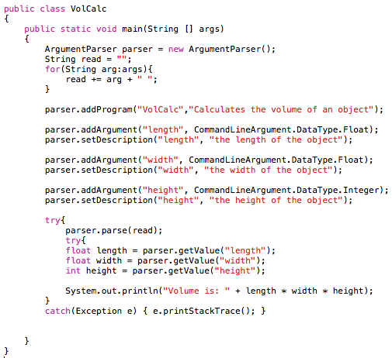
Sample Main

